Slide 1
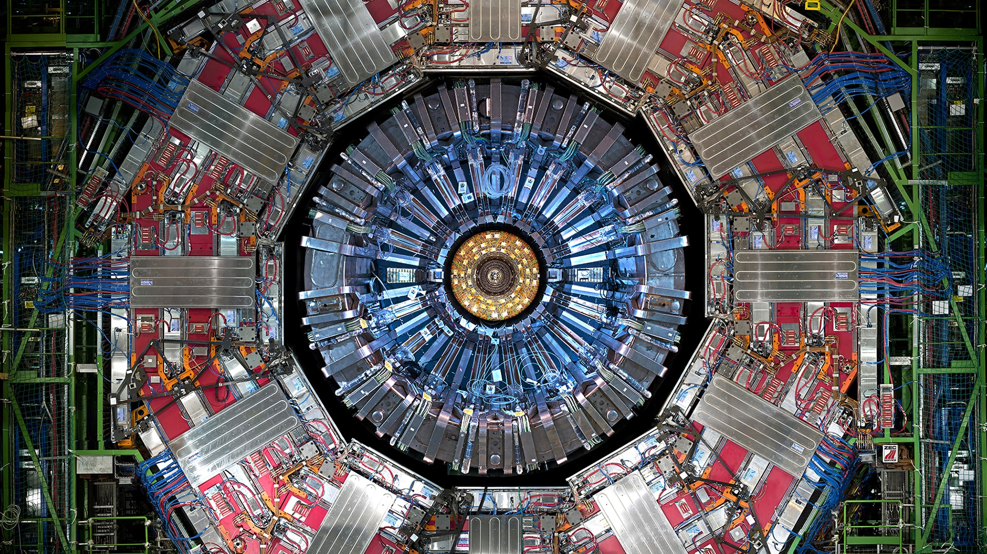
Chapter 3. The Dirac equation

Slide 2
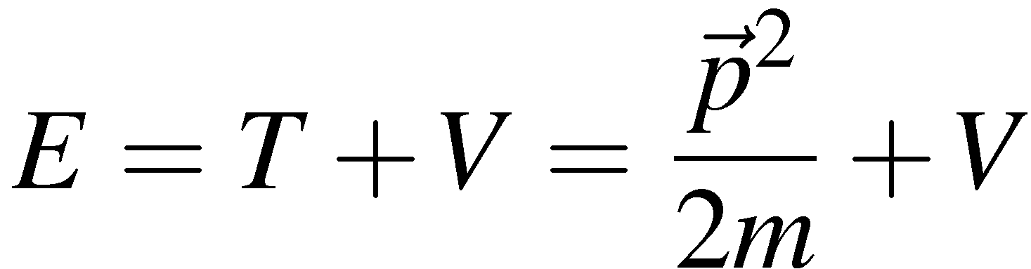
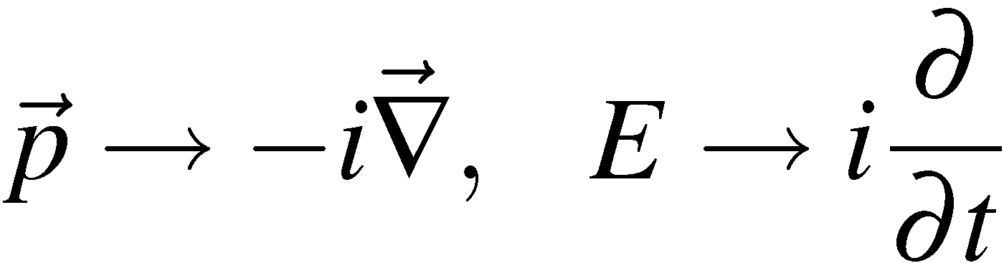
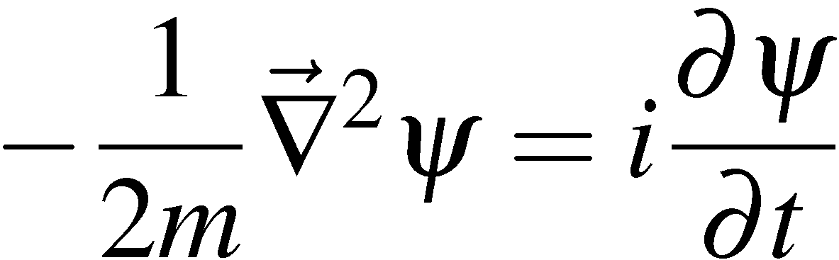
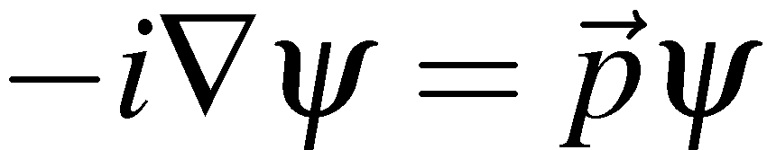
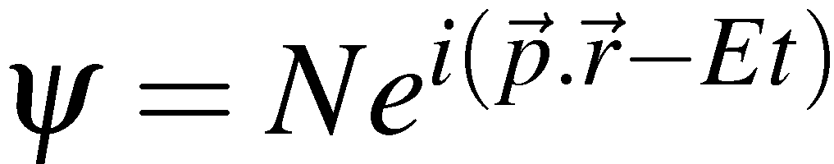
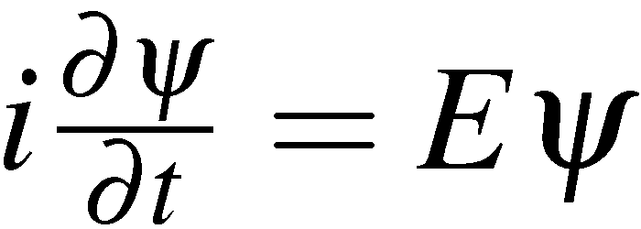
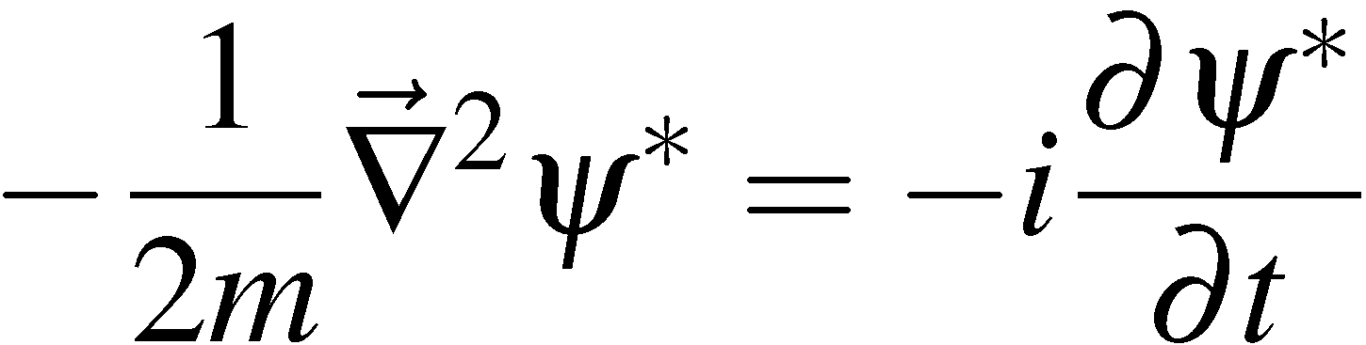
Non-Relativistic QM (Revision)
For particle physics need a relativistic formulation of quantum mechanics. But
first take a few moments to review the non-relativistic formulation QM
Take as the starting point non-relativistic energy:
In QM we identify the energy and momentum operators:
which gives the time dependent Schrödinger equation (take V=0 for simplicity)
(S1)
with plane wave solutions:
where
The SE is first order in the time derivatives and second order in spatial
derivatives – and is manifestly not Lorentz invariant.
In what follows we will use probability density/current extensively. For
the non-relativistic case these are derived as follows
(S1)*
(S2)
<número>

Slide 3
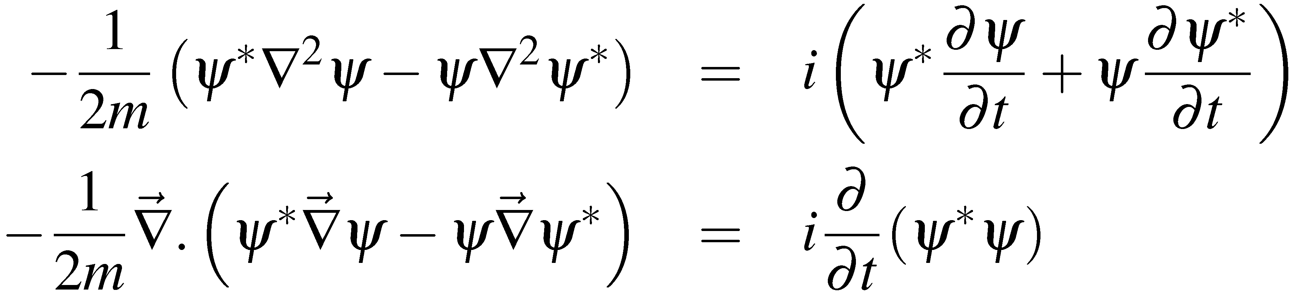
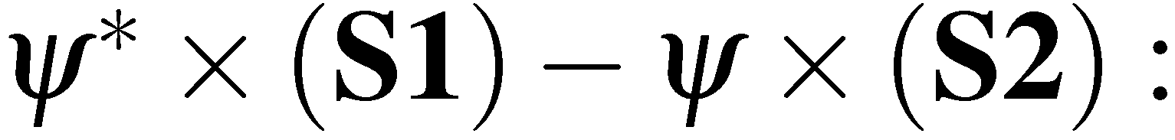
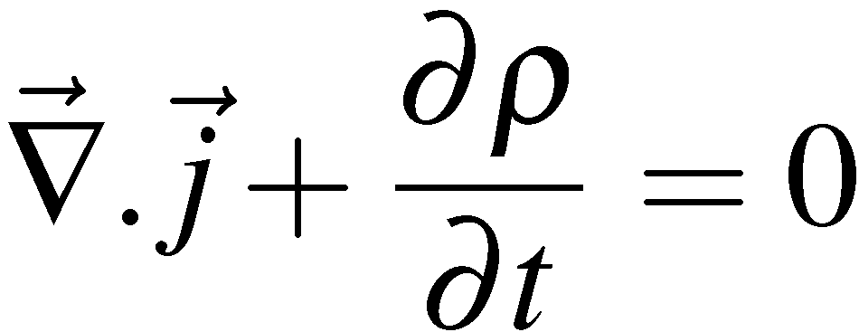
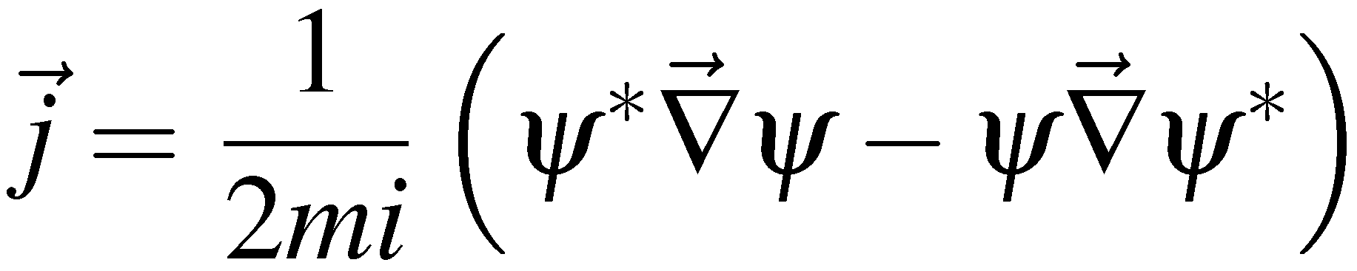
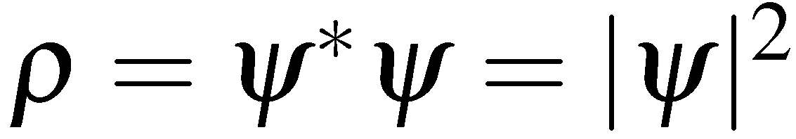
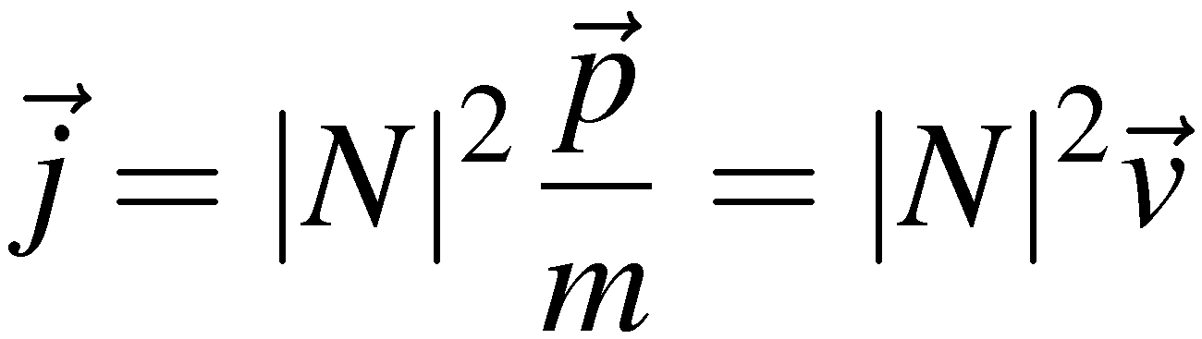
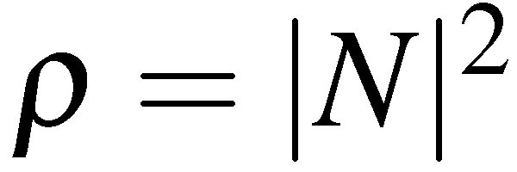
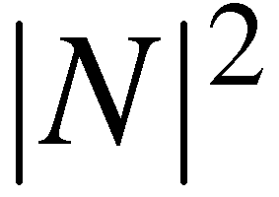
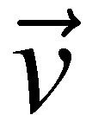
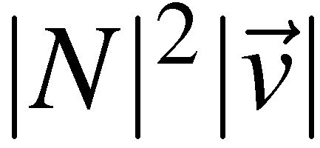
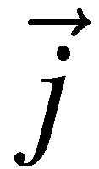
Which by comparison with the continuity equation
leads to the following expressions for probability density and current:
For a plane wave
and
The number of particles per unit volume is
For particles per unit volume moving at velocity , have passing
through a unit area per unit time (particle flux). Therefore is a vector in the
particle’s direction with magnitude equal to the flux.
<número>

Slide 4
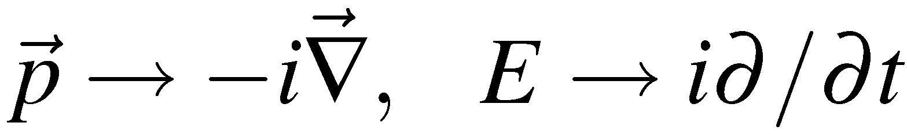
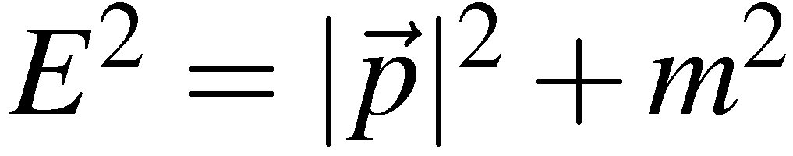
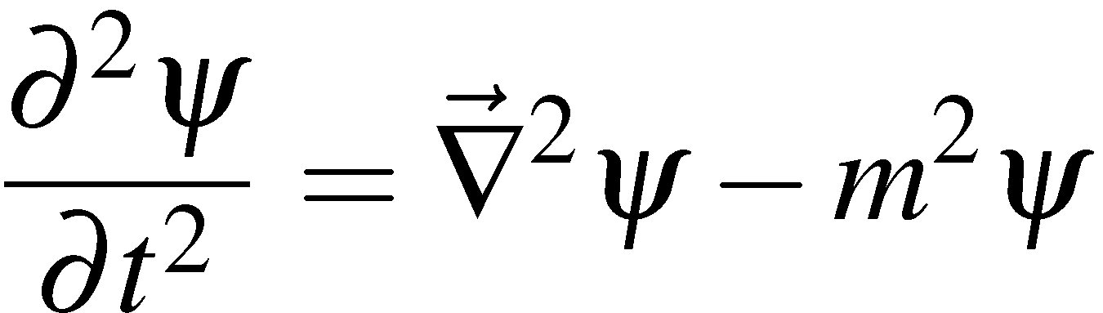
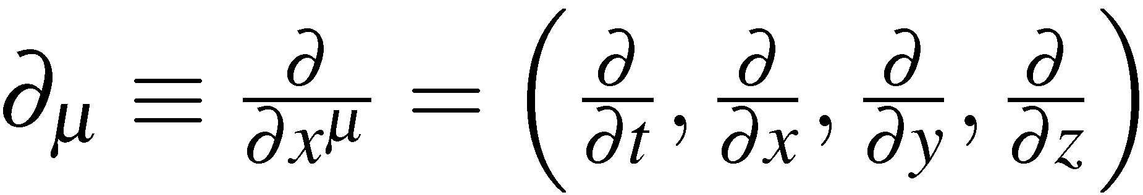
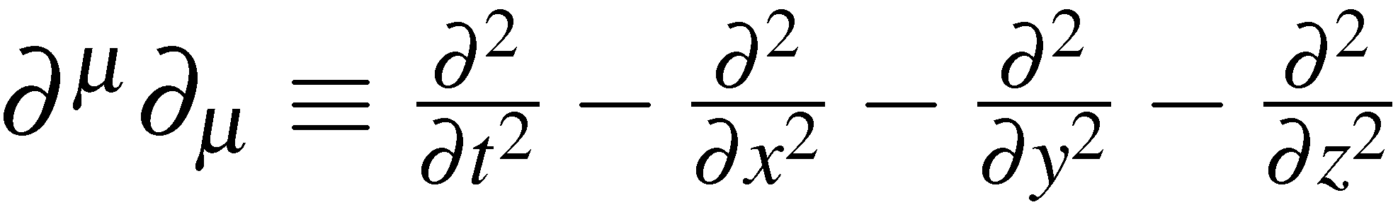
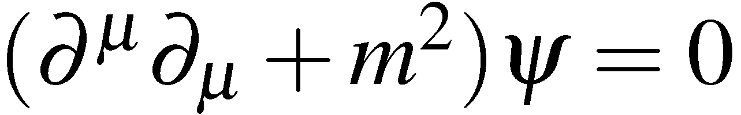
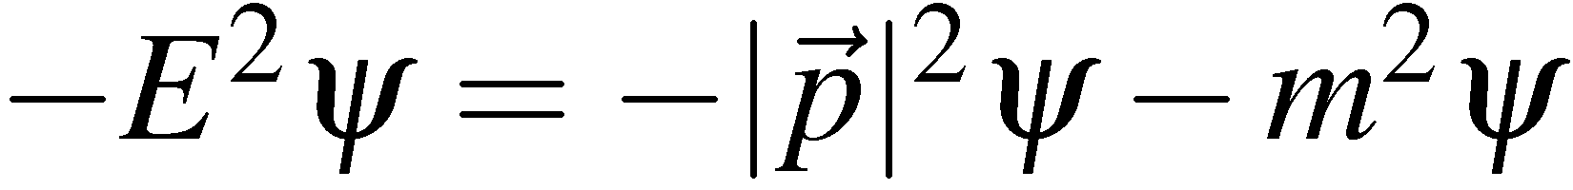
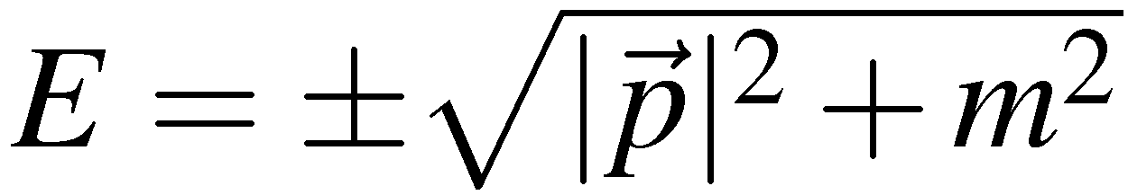
The Klein-Gordon Equation
Applying
to the relativistic equation for energy:
(KG1)
gives the Klein-Gordon equation:
(KG2)
Using
KG can be expressed compactly as
(KG3)
For plane wave solutions, , the KG equation gives:
Not surprisingly, the KG equation has negative energy solutions – this is
just what we started with in eq. KG1
Historically the –ve energy solutions were viewed as problematic. But for the KG
there is also a problem with the probability density…
<número>

Slide 5
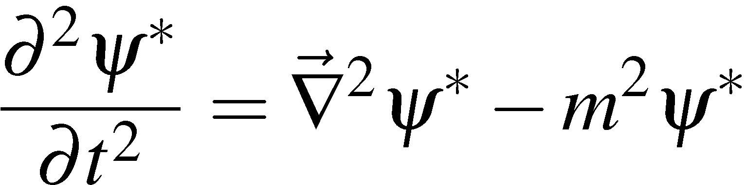
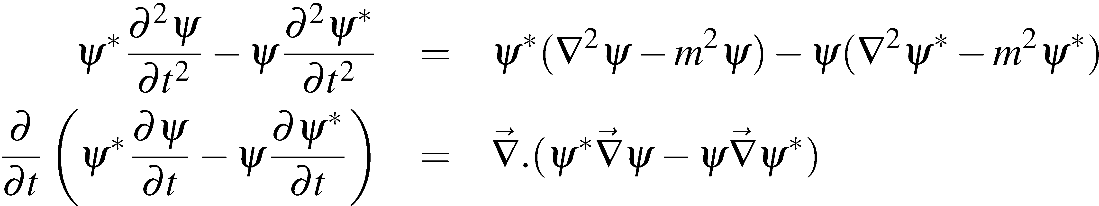
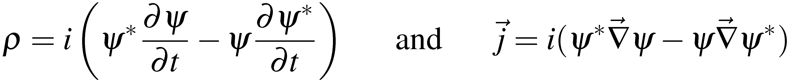
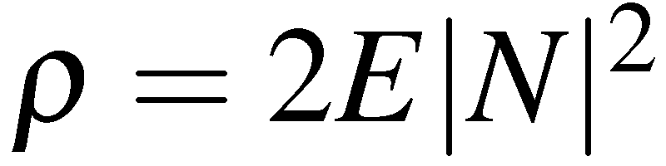
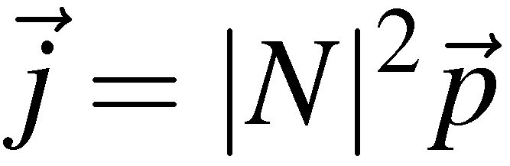
Proceeding as before to calculate the probability and current densities:
(KG2)*
(KG4)
Which, again, by comparison with the continuity equation allows us to identify
( i to ensure ρ
is always real)
For a plane wave
and
Particle densities are proportional to E. We might have anticipated this from the
previous discussion of Lorentz invariant phase space (i.e. density of 1/V in the
particles rest frame will appear as E/V in a frame where the particle has energy E
due to length contraction).
<número>

Slide 6
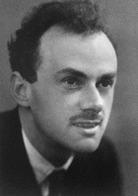
The Dirac Equation
Historically, it was thought that there were two main problems with the
Klein-Gordon equation:
Negative energy solutions
The negative particle densities associated with these solutions
We now know that in Quantum Field Theory these problems are
overcome and the KG equation is used to describe spin-0 particles
(inherently single particle description  multi-particle quantum
excitations of a scalar field).
Nevertheless:
These problems motivated Dirac (1928) to search for a
different formulation of relativistic quantum mechanics
in which all particle densities are positive.
The resulting wave equation had solutions which not only
solved this problem but also fully describe the
intrinsic spin and magnetic moment of the electron!
<número>

Slide 7
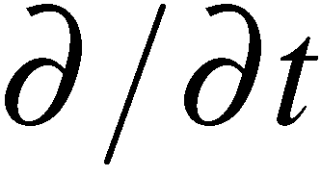
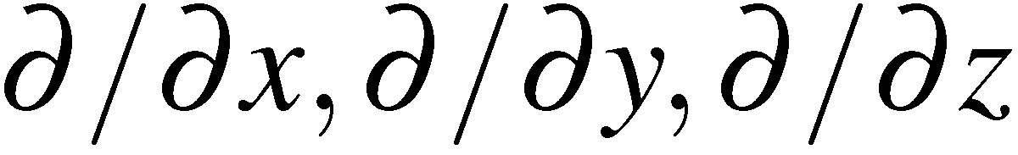
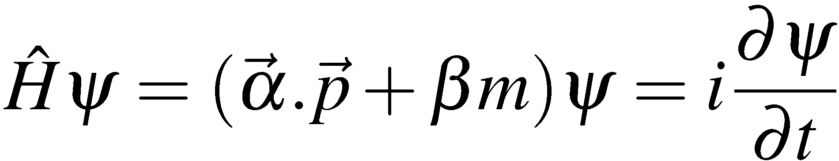

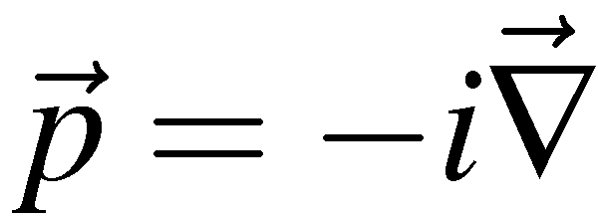
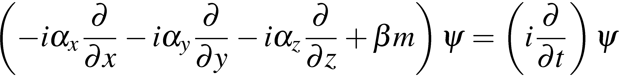
The Dirac Equation :
Schrödinger eqn:
1st order in
2nd order in
Klein-Gordon eqn:
2nd order throughout
Dirac looked for an alternative which was 1st order throughout:
(D1)
where
is the Hamiltonian operator and, as usual,
Writing (D1) in full:
“squaring” this equation gives
Which can be expanded in gory details as…
<número>

Slide 8
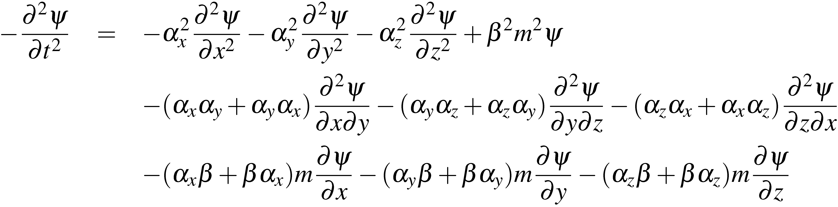
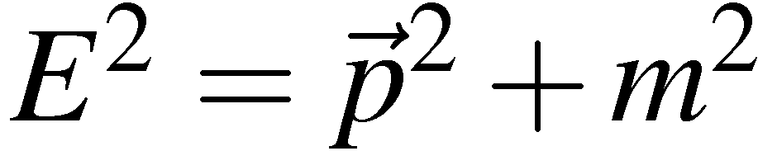
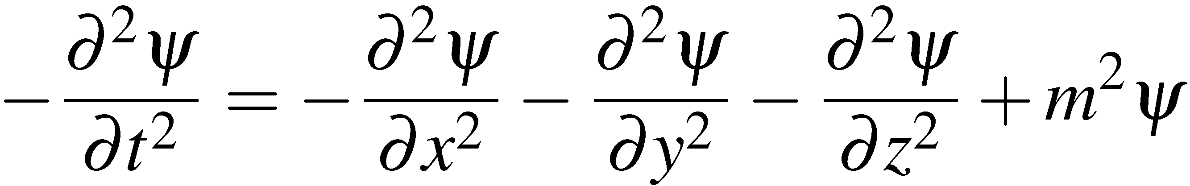
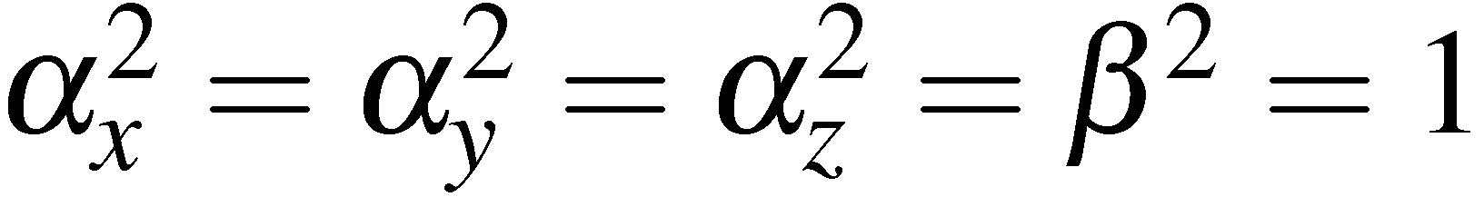
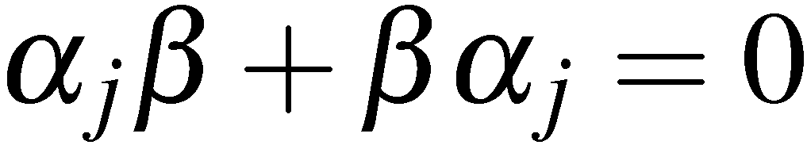
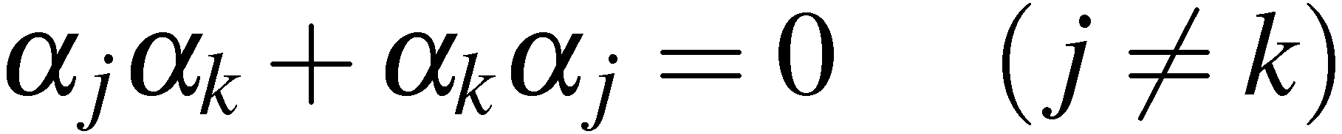
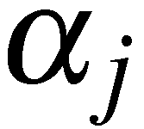
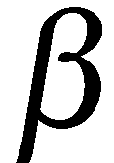
For this to be a reasonable formulation of relativistic QM, a free particle
must also obey , i.e. it must satisfy the Klein-Gordon equation:
Hence for the Dirac Equation to be consistent with the KG equation require:
(D2)
(D3)
(D4)
Immediately we see that the and cannot be numbers. Require 4
mutually anti-commuting matrices
Must be (at least) 4x4 matrices (see Appendix I)
<número>

Slide 9
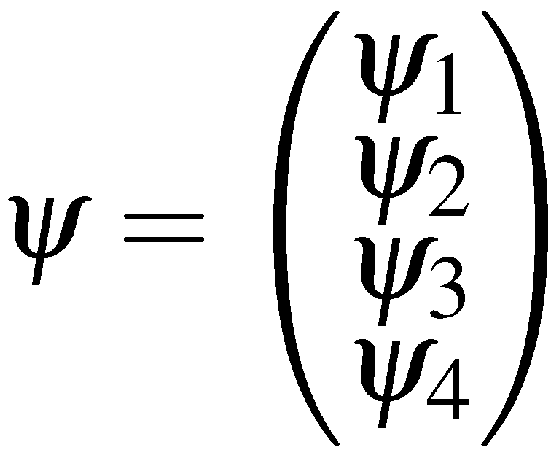
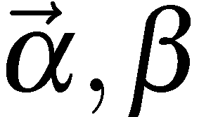
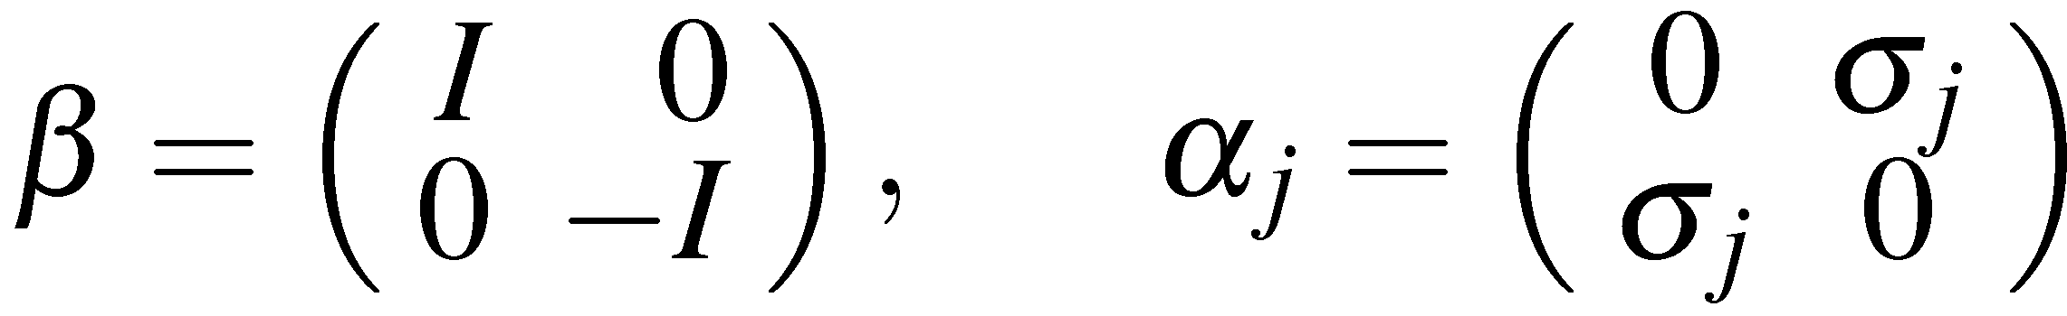
Consequently the wave-function must be a four-component
Dirac Spinor
A consequence of introducing an equation
that is 1st order in time/space derivatives is that
the wave-function has new degrees of freedom !
For the Hamiltonian to be Hermitian
E is always real !
requires
(D5)
i.e. the require four anti-commuting Hermitian 4x4 matrices.
At this point it is convenient to introduce an explicit representation for .
It should be noted that physical results do not depend on the particular
representation – everything is in the commutation relations.
A convenient choice is based on the Pauli spin matrices:
with
The matrices are Hermitian and anti-commute with each other
<número>

Slide 10
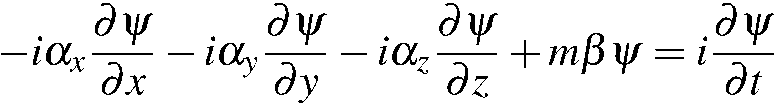




Dirac Equation: Probability Density and Current
Now consider probability density/current – this is where the perceived
problems with the Klein-Gordon equation arose.
Start with the Dirac equation
(D6)
and its Hermitian conjugate
(D7)
Consider
remembering are Hermitian
Now using the identity:
<número>

Slide 11





gives the continuity equation
(D8)
where
The probability density and current can be identified as:
and
where
Unlike the KG equation, the Dirac equation has probability densities which
are always positive.
In addition, the solutions to the Dirac equation are the four component
Dirac Spinors. A great success of the Dirac equation is that these
components naturally give rise to the property of intrinsic spin.
It can be shown that Dirac spinors represent spin-half particles (appendix II - next)
with an intrinsic magnetic moment of
(appendix III)
<número>

Slide 12






Appendix II : Spin
For a Dirac spinor is orbital angular momentum a good quantum number?
i.e. does commute with the Hamiltonian?
Consider the x component of L:
The only non-zero contributions come from:
Therefore
(A.1)
Hence the angular momentum does not commute with the Hamiltonian
and is not a constant of motion
<número>

Slide 13







Introduce a new 4x4 operator:
where are the Pauli spin matrices: i.e.
Now consider the commutator
here
and hence
Consider the x comp:
<número>

Slide 14




Taking each of the commutators in turn:
Hence
<número>

Slide 15









Hence the observable corresponding to the operator is also not
a constant of motion. However, referring back to (A.1)
Therefore:
Because
the commutation relationships for are the same as for the , e.g.
. Furthermore both S² and S_{z} are diagonal
Consequently
and for a particle travelling along
the z direction
S has all the properties of spin in quantum mechanics and therefore the
Dirac equation provides a natural account of the intrinsic angular
momentum of fermions
<número>

Slide 16




Covariant Notation: the Dirac γ Matrices
The Dirac equation can be written more elegantly by introducing the
four Dirac gamma matrices:
Premultiply the Dirac equation (D6) by
using
this can be written compactly as:
(D9)
NOTE: it is important to realise that the Dirac gamma matrices are not
four-vectors - they are constant matrices which remain invariant under a
Lorentz transformation. However it can be shown that the Dirac equation
is itself Lorentz covariant (see Appendix IV)
<número>

Slide 17





Properties of the γ matrices
From the properties of the and matrices (D2)-(D4) immediately obtain:
and
The full set of relations is
which can be expressed as:
(defines the algebra)
Are the gamma matrices Hermitian?
is Hermitian so is Hermitian.
The matrices are also Hermitian, giving
Hence
are anti-Hermitian
<número>

Slide 18






Pauli-Dirac Representation
From now on we will use the Pauli-Dirac representation of the gamma matrices:
which when written in full are
Using the gamma matrices
and
can be written as:
where is the four-vector current.
(The proof that is indeed a four vector is given in Appendix V.)
In terms of the four-vector current the continuity equation becomes
Finally the expression for the four-vector current
can be simplified by introducing the adjoint spinor
<número>

Slide 19



The Adjoint Spinor
The adjoint spinor is defined as
i.e.
In terms the adjoint spinor the four vector current can be written:
We will use this expression in deriving the Feynman rules for the
Lorentz invariant matrix element for the fundamental interactions.
That’s enough notation, start to investigate the free particle solutions
of the Dirac equation...
<número>

Slide 20







Dirac Equation: Free Particle at Rest
Look for free particle solutions to the Dirac equation of form:
where , which is a constant four-component spinor which must satisfy
the Dirac equation
Consider the derivatives of the free particle solution
substituting these into the Dirac equation gives:
which can be written:
(D10)
This is the Dirac equation in “momentum” – note it contains no derivatives.
For a particle at rest
and
eq. (D10)
<número>

Slide 21



(D11)
This equation has four orthogonal solutions:
(D11)
E = m
(D11)
E = -m
still have NEGATIVE ENERGY SOLUTIONS
(Question 6)
Including the time dependence from
gives
Two spin states with E>0
Two spin states with E<0
In QM mechanics can’t just discard the E<0 solutions as unphysical
as we require a complete set of states - i.e. 4 SOLUTIONS
<número>

Slide 22






Dirac Equation: Plane Wave Solutions
Now aim to find general plane wave solutions:
Start from Dirac equation (D10):
and use
Note
Note in the above equation the 4x4 matrix is
written in terms of four 2x2 sub-matrices
Writing the four component
spinor as
Giving two coupled
simultaneous equations
for
(D12)
<número>

Slide 23







Expanding
Therefore
(D12)
gives
Solutions can be obtained by making the arbitrary (but simplest) choices for
i.e.
or
where N is the wave-function normalisation
giving
and
NOTE:
For these correspond to the E>0 particle at rest solutions
The choice of is arbitrary, but this isn’t an issue since we can express any
other choice as a linear combination. It is analogous to choosing a basis for
spin which could be eigenfunctions of S_{x}, S_{y} or S_{z}
<número>

Slide 24








Repeating for
and
gives the solutions and
The four solutions are:
If any of these solutions is put back into the Dirac equation, as expected, we obtain
which doesn’t in itself identify the negative energy solutions.
One rather subtle point: One could ask the question whether we can interpret
all four solutions as positive energy solutions. The answer is no. If we take
all solutions to have the same value of E, i.e. E = +|E|, only two of the solutions
are found to be independent.
There are only four independent solutions when the two are taken to have E<0.
To identify which solutions have E<0 energy refer back to particle at rest (eq. D11 ).
For : correspond to the E>0 particle at rest solutions
correspond to the E<0 particle at rest solutions
So
are the +ve energy solutions and are the -ve energy solutions
<número>

Slide 25


Interpretation of –ve Energy Solutions
The Dirac equation has negative energy solutions. Unlike the KG equation
these have positive probability densities. But how should –ve energy
solutions be interpreted? Why don’t all +ve energy electrons fall into
to the lower energy –ve energy states?
Dirac Interpretation: the vacuum corresponds to all –ve energy states
being full with the Pauli exclusion principle preventing electrons falling into
-ve energy states. Holes in the –ve energy states correspond to +ve energy
anti-particles with opposite charge. Provides a picture for pair-production
and annihilation.
.
.
.
.
.
.
.
.
.
.
.
.
mc²
mc²
mc²
γ
γ
-mc²
-mc²
-mc²
.
.
.
.
.
.
.
.
.
.
.
.
<número>

Slide 26


Discovery of the Positron
Cosmic ray track in cloud chamber:
C.D.Anderson, Phys Rev 43 (1933) 491
B
e⁺
23 MeV
6 mm Lead Plate
e⁺
63 MeV
e⁺ enters at bottom, slows down in the
lead plate – know direction
Curvature in B-field shows that it is a
positive particle
Can’t be a proton as would have stopped in the lead
Provided Verification of Predictions of Dirac Equation
Anti-particle solutions exist ! But the picture of the vacuum corresponding to
the state where all –ve energy states are occupied is rather unsatisfactory, what
about bosons (no exclusion principle),….
<número>

Slide 27


Feynman-Stückelberg Interpretation
There are many problems with the Dirac interpretation of anti-particles
and it is best viewed as of historical interest – don’t take it too seriously.
Feynman-Stückelberg Interpretation:
Interpret a negative energy solution as a negative energy particle which
propagates backwards in time or equivalently a positive energy anti-particle
which propagates forwards in time
e– (E<0)
e⁺ (E>0)
γ
γ
time
e⁺
e⁻
E>0
E<0
e– (E>0)
e– (E>0)
NOTE: in the Feynman diagram the arrow on the anti-particle remains in the backwards in time direction to label it an anti-particle solution.
At this point it become more convenient to work with anti-particle
wave-functions with motivated by this interpretation
<número>

Slide 28




Anti-Particle Spinors
Want to redefine our –ve energy solutions such that:
i.e. the energy of the physical anti-particle.
We can look at this in two ways:
❶
Start from the negative energy solutions
Where E is understood to
be negative
Can simply “define” anti-particle wave-function by flipping the sign
of and following the Feynman-Stückelburg interpretation:
where E is now understood to be positive,
<número>

Slide 29






Anti-Particle Spinors
❷
Find negative energy plane wave solutions to the Dirac equation of
the form:
where
Note that although
these are still negative energy solutions
in the sense that
Solving the Dirac equation
(D13)
The Dirac equation in terms of momentum for ANTI-PARTICLES (c.f. D10)
Proceeding as before:
etc., …
The same wave-functions that were written down on the previous page.
<número>

Slide 30








Particle and anti-particle Spinors
Four solutions of form:
Four solutions of form
Since we have a four component spinor, only four are linearly independent
Could choose to work with or or …
Natural to use choose +ve energy solutions
<número>

Slide 31







Wave-Function Normalisation
From handout 1 want to normalise wave-functions
to particles per unit volume
Consider
Probability density
which for the desired 2E particles per unit volume, requires that
Obtain same value of N for
<número>

Slide 32







Charge Conjugation
In the part II Relativity and Electrodynamics course it was shown that
the motion of a charged particle in an electromagnetic field
can be obtained by making the minimal substitution
with
this can be written
and the Dirac equation becomes:
Taking the complex conjugate and pre-multiplying by
But
and
(D14)
Define the charge conjugation operator:
<número>

Slide 33










D14 becomes:
Comparing to the original equation
we see that the spinor describes a particle of the same mass but with
opposite charge, i.e. an anti-particle !
particle spinor  anti-particle spinor
Now consider the action of on the free particle wave-function:
hence
similarly
Under the charge conjugation operator the particle spinors and
transform to the anti-particle spinors and
<número>

Slide 34










Using the anti-particle solutions
There is a subtle but important point about the anti-particle solutions written as
Applying normal QM operators for momentum and energy
gives
and
But have defined solutions to have E>0
Hence the quantum mechanical operators giving the physical energy and
momenta of the anti-particle solutions are:
and
Under the transformation
:
Conservation of total angular momentum
The physical spin of the anti-particle solutions is given by
0
A spin-up hole leaves the
negative energy sea in a spin
down state
In the hole picture:
-mc²
.
<número>

Slide 35



Summary of Solutions to the Dirac Equation
The normalised free PARTICLE solutions to the Dirac equation:
satisfy
with
The ANTI-PARTICLE solutions in terms of the physical energy and momentum:
satisfy
with
For these states the spin is given by
For both particle and anti-particle solutions:
(Now try question 7 – mainly about 4 vector current )
<número>

Slide 36










Spin States
In general the spinors are not Eigenstates of
(Appendix II)
However particles/anti-particles travelling in the z-direction:
are Eigenstates of
Note the change of sign
of when dealing with
antiparticle spinors
z
z
Spinors are only eigenstates of for
<número>

Slide 37

Pause for Breath…
Have found solutions to the Dirac equation which are also eigenstates but
only for particles travelling along the z axis.
Not a particularly useful basis
More generally, want to label our states in terms of “good quantum numbers”,
i.e. a set of commuting observables.
Can’t use z component of spin:
(Appendix II)
Introduce a new concept “HELICITY”
Helicity plays an important role in much that follows
<número>

Slide 38







Helicity
The component of a particles spin along its direction of flight is a good quantum
number:
Define the component of a particles spin along its direction of flight as HELICITY:
If we make a measurement of the component of spin of a spin-half particle
along any axis it can take two values , consequently the eigenvalues
of the helicity operator for a spin-half particle are:
Often termed:
“right-handed”
“left-handed”
NOTE: these are “RIGHT-HANDED” and LEFT-HANDED HELICITY eigenstates
In handout 4 we will discuss RH and LH CHIRAL eigenstates. Only in the limit
are the HELICITY eigenstates the same as the CHIRAL eigenstates
<número>

Slide 39











Helicity Eigenstates
Wish to find solutions of Dirac equation which are also eigenstates of Helicity:
where and are right and left handed helicity states and here is
the unit vector in the direction of the particle.
The eigenvalue equation:
gives the coupled equations:
(D15)
Consider a particle propagating in direction
<número>

Slide 40









Writing either
or
then (D15) gives the relation
(For helicity )
So for the components of BOTH and
For the right-handed helicity state, i.e. helicity +1:
Putting in the constants of proportionality gives:
<número>

Slide 41






From the Dirac Equation (D12) we also have
(D16)
Helicity
(D15) determines the relative normalisation of and , i.e. here
The negative helicity particle state is obtained in the same way.
The anti-particle states can also be obtained in the same manner although
it must be remembered that
i.e.
<número>

Slide 42




The particle and anti-particle helicity eigenstates states are:
particles
anti-particles
For all four states, normalising to 2E particles/Volume again gives
The helicity eigenstates will be used extensively in the calculations that follow.
<número>

Slide 43









Intrinsic Parity of Dirac Particles
Before leaving the Dirac equation, consider parity
The parity operation is defined as spatial inversion through the origin:
Consider a Dirac spinor, , which satisfies the Dirac equation
(D17)
Under the parity transformation:
Try
so
(D17)
Expressing derivatives in terms of the primed system:
Since anti-commutes with :
<número>

Slide 44










Pre-multiplying by
Which is the Dirac equation in the new coordinates.
There for under parity transformations the form of the Dirac equation is
unchanged provided Dirac spinors transform as
(note the above algebra doesn’t depend on the choice of )
For a particle/anti-particle at rest the solutions to the Dirac Equation are:
with
etc.
Hence an anti-particle at rest has opposite intrinsic parity to a particle at rest.
Convention: particles are chosen to have +ve parity; corresponds to choosing
<número>

Slide 45

Summary
The formulation of relativistic quantum mechanics starting from the
linear Dirac equation
New degrees of freedom : found to describe Spin ½ particles
In terms of 4x4 gamma matrices the Dirac Equation can be written:
Introduces the 4-vector current and adjoint spinor:
With the Dirac equation: forced to have two positive energy and two
negative energy solutions
Feynman-Stückelberg interpretation: -ve energy particle solutions
propagating backwards in time correspond to physical +ve energy
anti-particles propagating forwards in time
<número>

Slide 46


Most useful basis: particle and anti-particle helicity eigenstates
In terms of 4-component spinors, the charge conjugation and parity
operations are:
Now have all we need to know about a relativistic description of
particles… next discuss particle interactions and QED.
<número>

Slide 47






Appendix I : Dimensions of the Dirac Matrices
non-examinable
Starting from
For to be Hermitian for all requires
To recover the KG equation:
Consider
with
Therefore
(using commutation relation)
similarly
<número>

Slide 48





We can now show that the matrices are of even dimension by considering
the eigenvalue equation, e.g.
Eigenvalues of a Hermitian matrix are real so
but
Since the are trace zero Hermitian matrices with eigenvalues of
they must be of even dimension
For N=2 the 3 Pauli spin matrices satisfy
But we require 4 anti-commuting matrices. Consequently the of the
Dirac equation must be of dimension 4, 6, 8,….. The simplest choice for
is to assume that the are of dimension 4.
<número>

Slide 49
Appendix II : Spin
non-examinable
For a Dirac spinor is orbital angular momentum a good quantum number?
i.e. does commute with the Hamiltonian?
Consider the x component of L:
The only non-zero contributions come from:
Therefore
(A.1)
Hence the angular momentum does not commute with the Hamiltonian
and is not a constant of motion
<número>

Slide 50
Introduce a new 4x4 operator:
where are the Pauli spin matrices: i.e.
Now consider the commutator
here
and hence
Consider the x comp:
<número>

Slide 51
Taking each of the commutators in turn:
Hence
<número>

Slide 52
Hence the observable corresponding to the operator is also not
a constant of motion. However, referring back to (A.1)
Therefore:
Because
the commutation relationships for are the same as for the , e.g.
. Furthermore both S² and S_{z} are diagonal
Consequently
and for a particle travelling along
the z direction
S has all the properties of spin in quantum mechanics and therefore the
Dirac equation provides a natural account of the intrinsic angular
momentum of fermions
<número>

Slide 53







Appendix III : Magnetic Moment
non-examinable
In the part II Relativity and Electrodynamics course it was shown that
the motion of a charged particle in an electromagnetic field
can be obtained by making the minimal substitution
Applying this to equations (D12)
(A.2)
Multiplying (A.2) by
(A.3)
where kinetic energy
In the non-relativistic limit (A.3) becomes
(A.4)
<número>

Slide 54







Now
which leads to
and
The operator on the LHS of (A.4):
Substituting back into (A.4) gives the Schrödinger-Pauli equation for
the motion of a non-relativisitic spin ½ particle in an EM field
<número>

Slide 55







Since the energy of a magnetic moment in a field is we can
identify the intrinsic magnetic moment of a spin ½ particle to be:
In terms of the spin:
Classically, for a charged particle current loop
The intrinsic magnetic moment of a spin half Dirac particle is twice
that expected from classical physics. This is often expressed in terms
of the gyromagnetic ratio is g=2.
<número>

Slide 56






Appendix IV : Covariance of Dirac Equation
non-examinable
For a Lorentz transformation we wish to demonstrate that the Dirac
Equation is covariant i.e.
(A.5)
transforms to
(A.6)
where
and
is the transformed spinor.
The covariance of the Dirac equation will be established if the 4x4 matrix
S exists.
Consider a Lorentz transformation with the primed frame moving with
velocity v along the x axis
where
<número>

Slide 57







With this transformation equation (A.6)
which should be compared to the matrix S multiplying (A.5)
Therefore the covariance of the Dirac equation will be demonstrated if
we can find a matrix S such that
(A.7)
Considering each value of
where
and
<número>

Slide 58




It is easy (although tedious) to demonstrate that the matrix:
with
satisfies the above simultaneous equations
NOTE: For a transformation along in the –x direction
To summarise, under a Lorentz transformation a spinor transforms
to . This transformation preserves the mathematical
form of the Dirac equation
<número>

Slide 59






Appendix V : Transformation of Dirac Current
non-examinable
The Dirac current plays an important rôle in the description
of particle interactions. Here we consider its transformation properties.
Under a Lorentz transformation we have
and for the adjoint spinor:
First consider the transformation properties of
where
giving
hence
The product is therefore a Lorentz invariant. More generally, the
product is Lorentz covariant
<número>

Slide 60









Now consider
To evaluate this wish to express in terms of
(A.7)
where we used
Rearranging the labels and reordering gives:
Hence the Dirac current, , transforms as a four-vector
<número>

